Slide 1
Track the following interactions in Google tag manager for https://beyondboardingpasses.blogspot.com/
● Link clicks
● Page load
● Time (How long a visitor stayed on a particular page )
● Button click

Slide 2
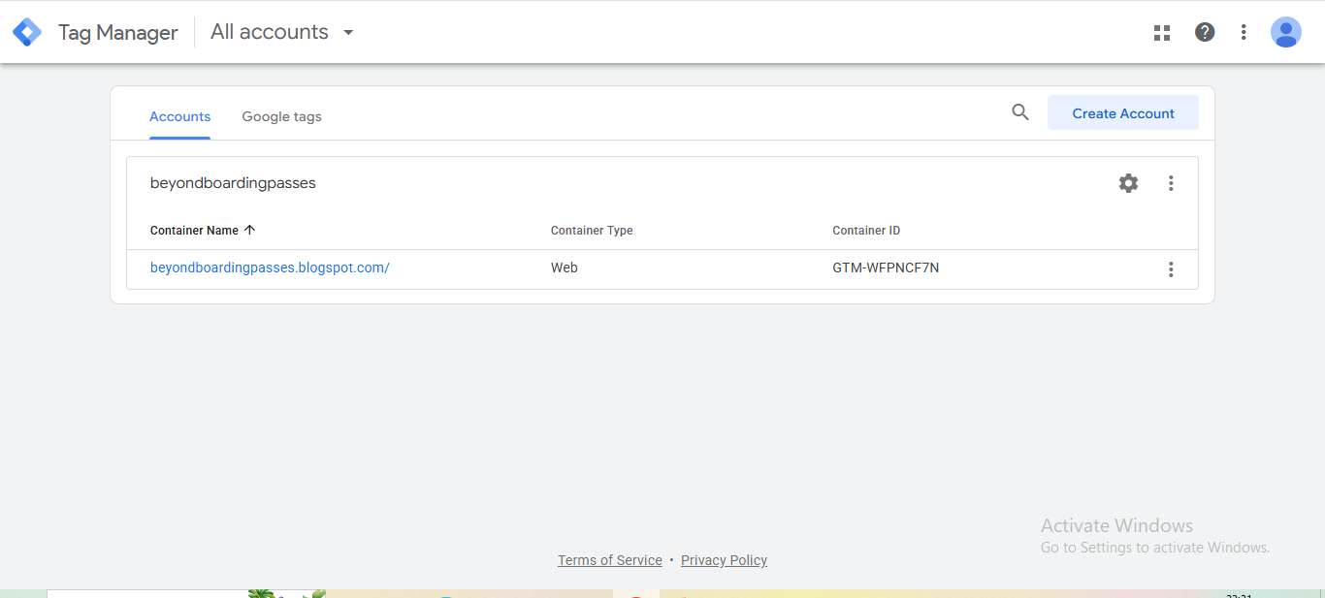

Slide 3
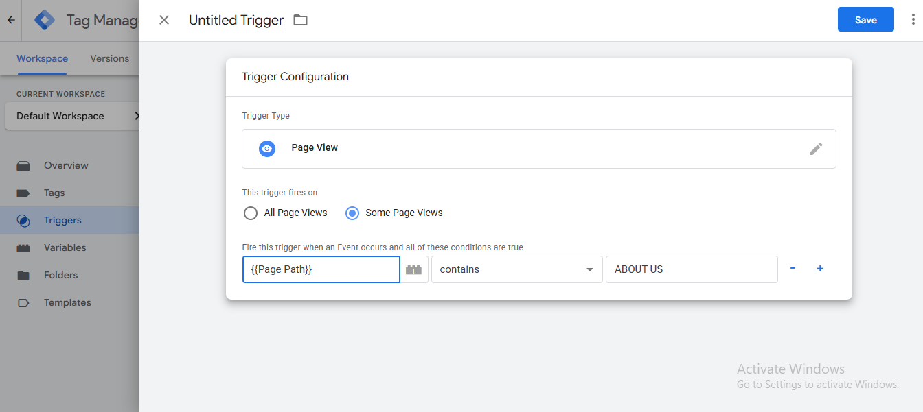
Page View

Slide 4
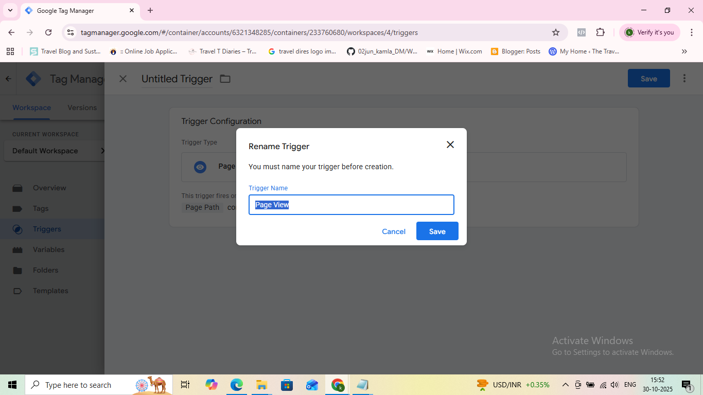

Slide 5
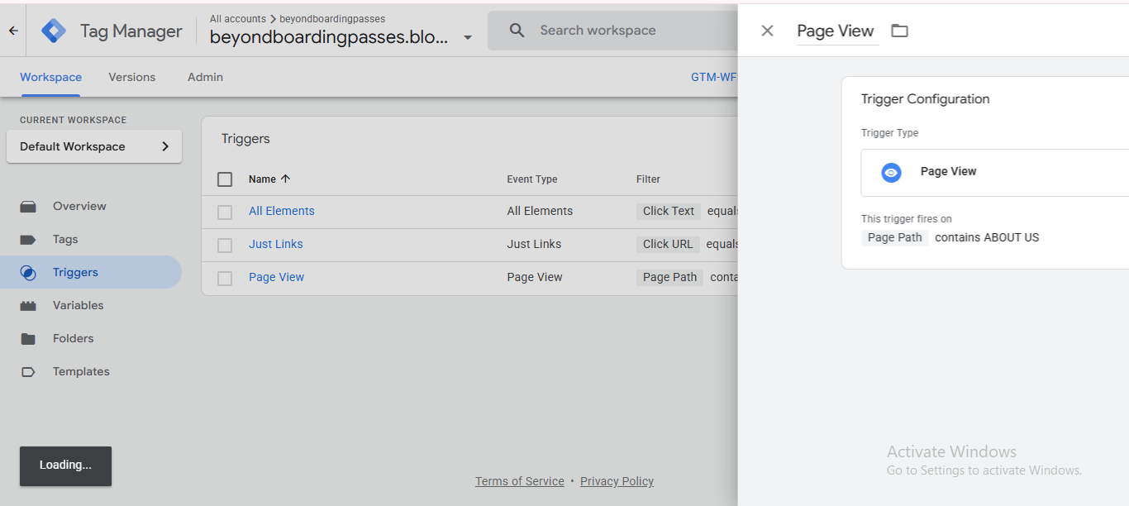

Slide 6
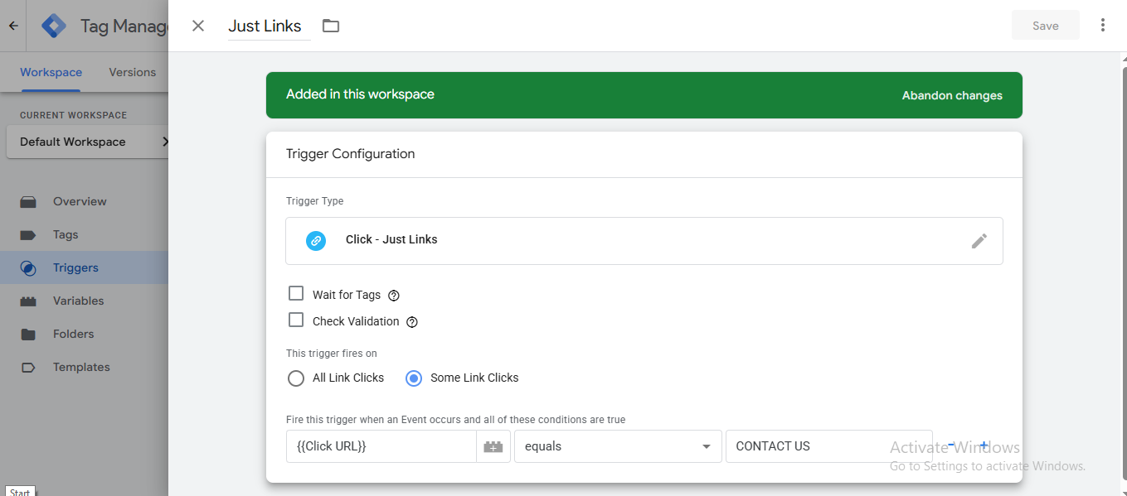
Just Links

Slide 7
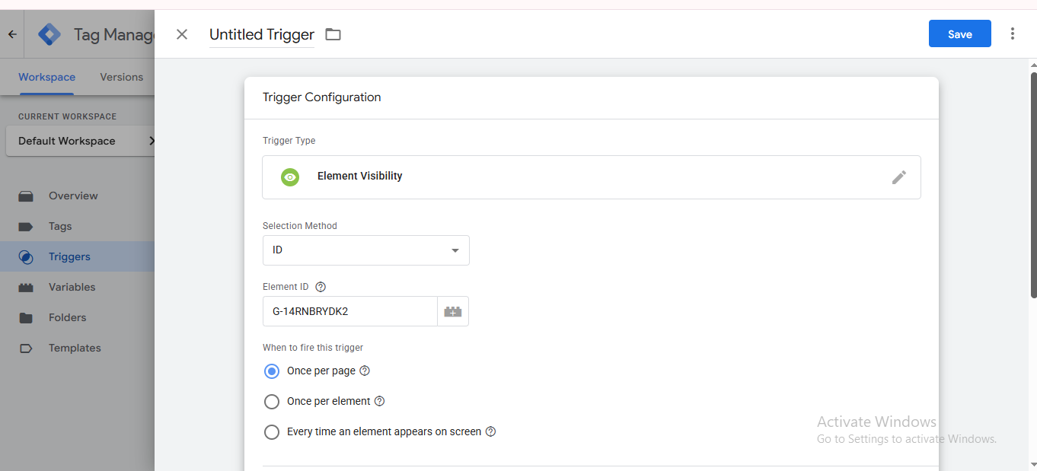
Element Visibility

Slide 8
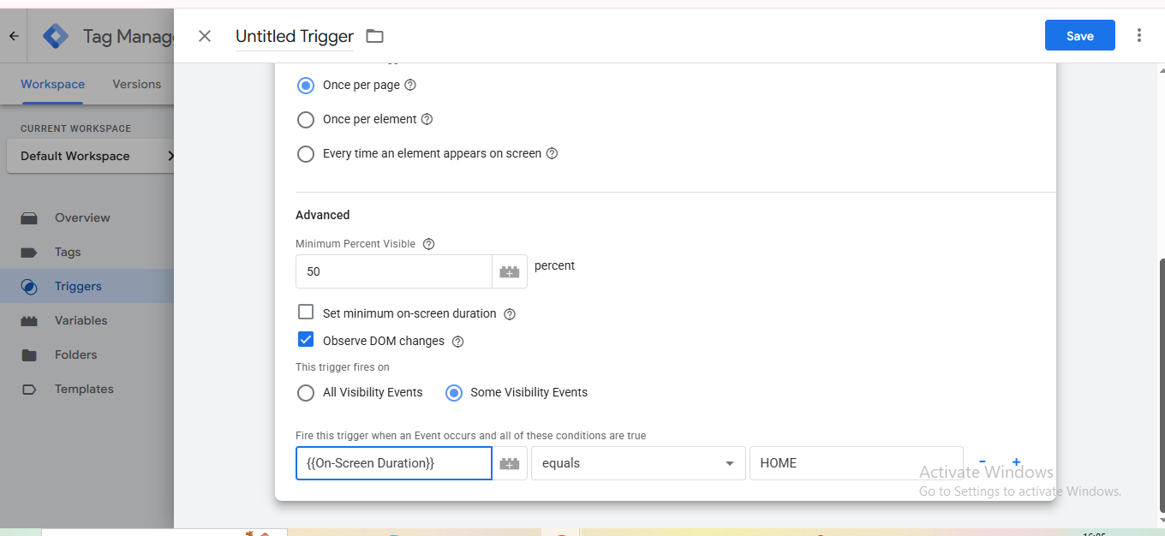

Slide 9
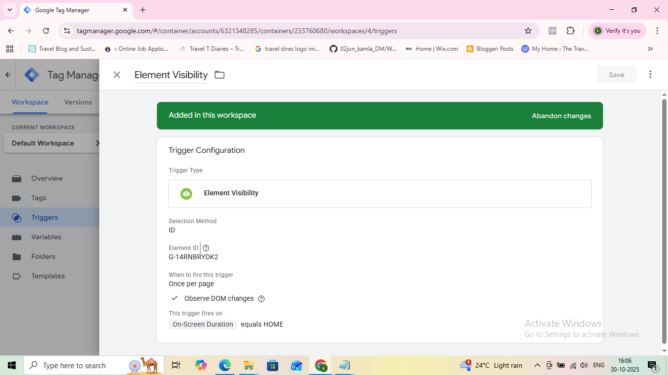

Slide 10
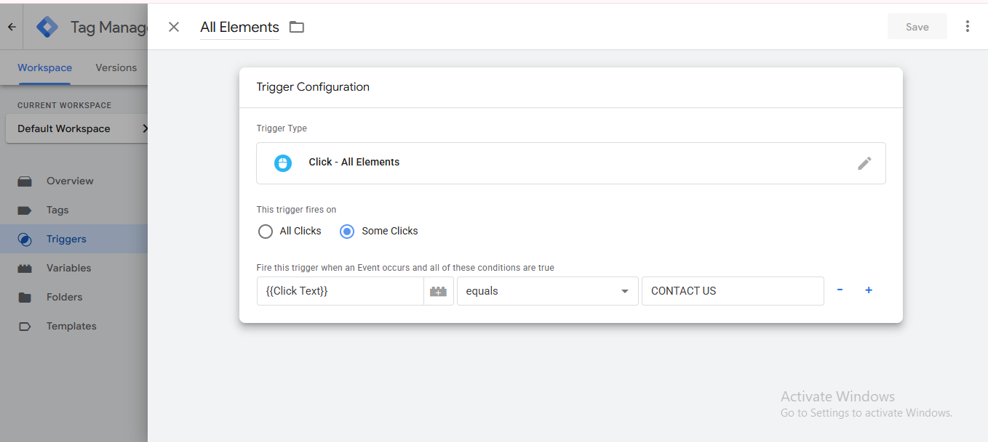
Click – All Elements

Slide 11
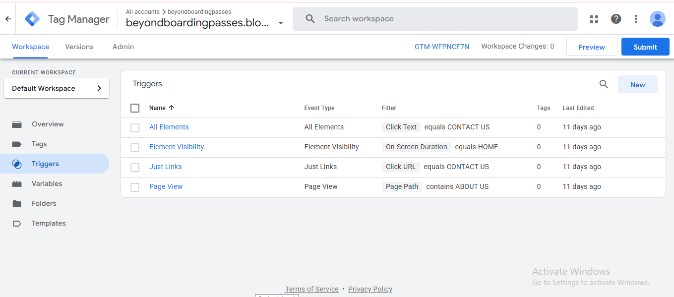

Slide 12
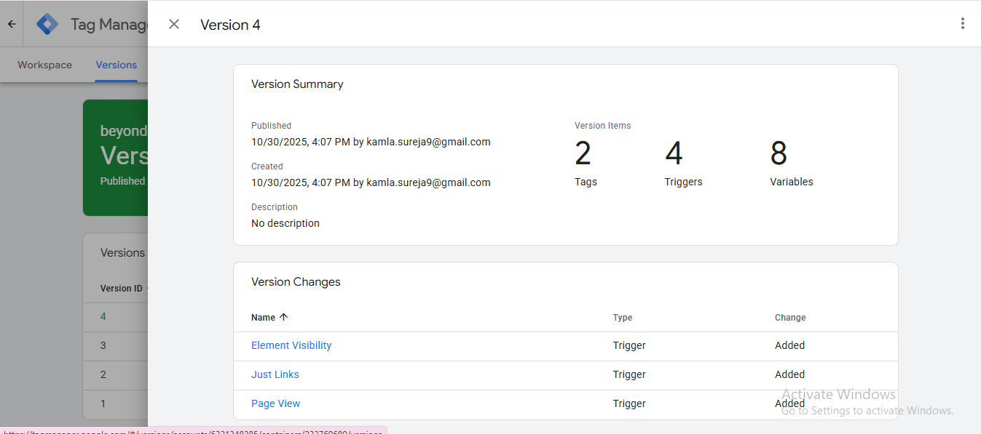

Slide 13
